Slide 1
Topic 1: Acoustics and Energy
In Rooms and Loudspeakers

Slide 2
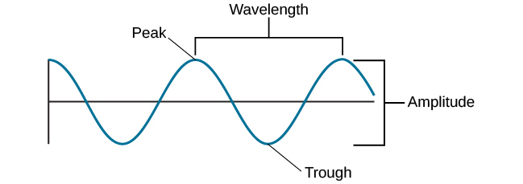
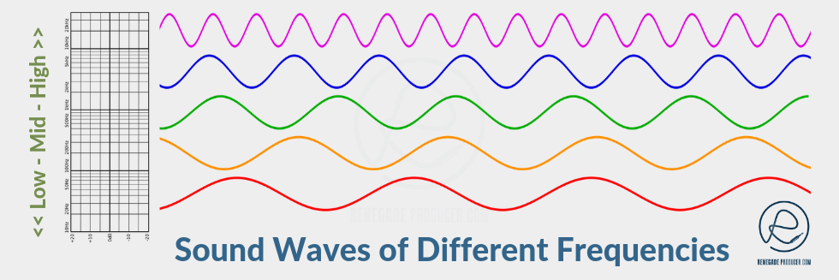
Wave Diagram
Wavelengths get longer as frequency decreases
Longer wavelengths require more energy to sustain
Bass needs more energy

Slide 3
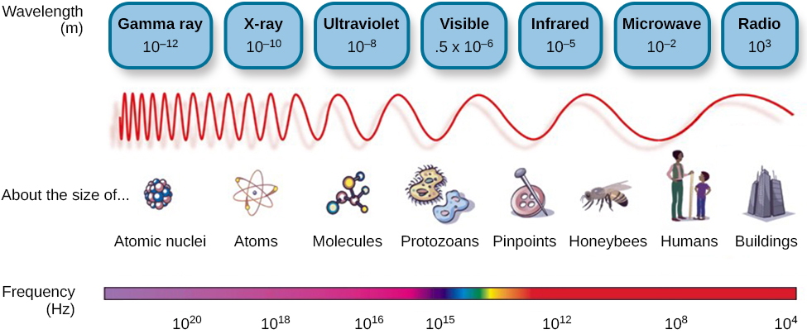
Vibration Frequency
Mechanical energy
Electro/Magnetic energy
In Loudspeakers…
- Octave = ½ x Frequency
- Octave = 2 x Wavelength
- Octave = 4 x Energy

Slide 4
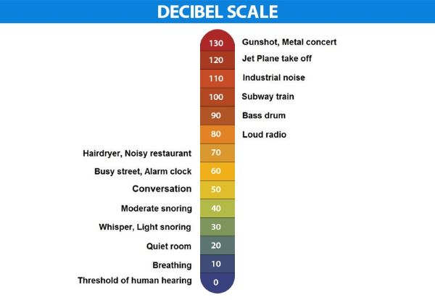
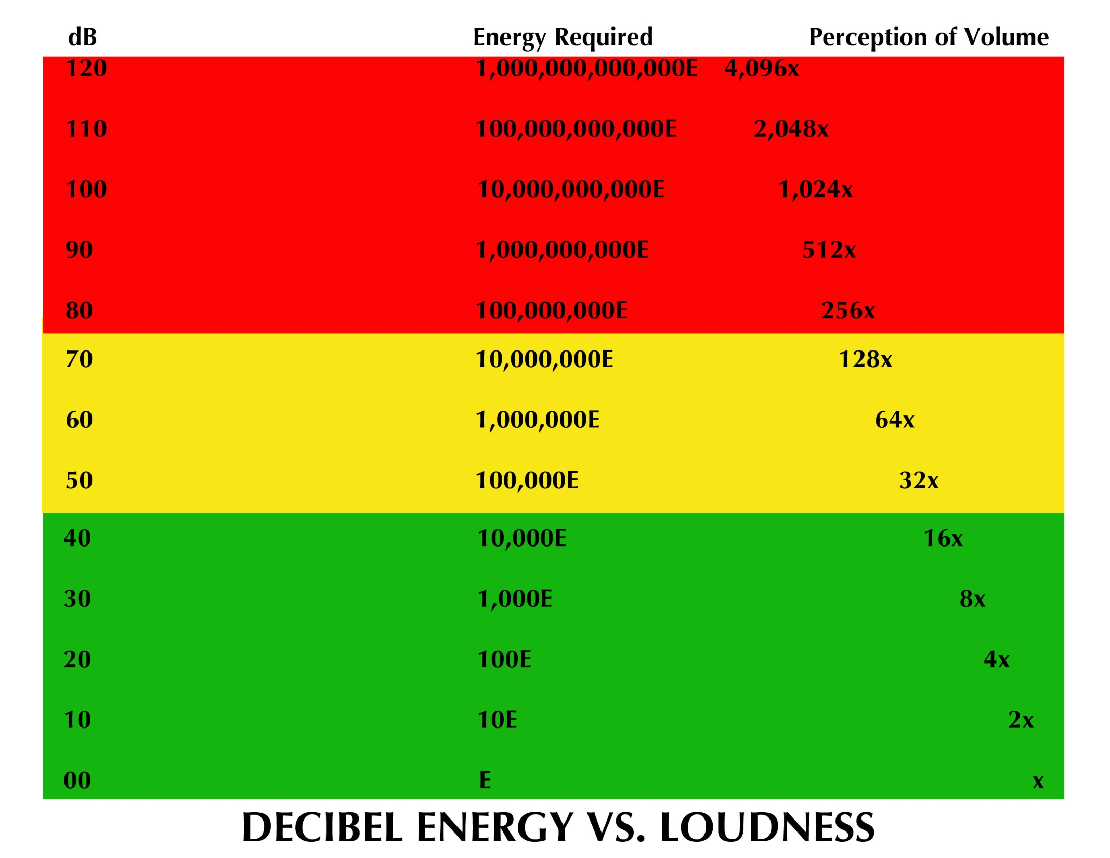
Decibel energy vs. Loudness
+3dB = 2 x Energy
+10dB = 10 x Energy
2x loud = 10 x Energy etc.
In the Context of room size…
2x Room (size) = 4 x Energy

Slide 5
Energy Summary
Louder requires more energy
Deeper requires more energy
Bigger rooms require more energy
Rooms with greater damping (absorption) require more energy

Slide 6
Topic 2: Acoustics
Physics of Sound

Slide 7
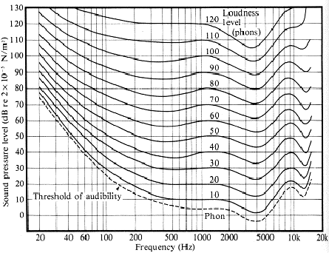
Human Hearing Range
20 Hz – 20,000 Hz
20-300 Hz – Bass
300-3,000 Hz – Midrange
3,000-20,000 Hz – Treble
Human speech – 100-6,000 Hz

Slide 8
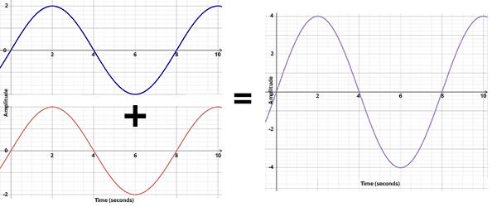
In-Phase waveforms
Peaks and troughs align which sums together and reinforces one another

Slide 9
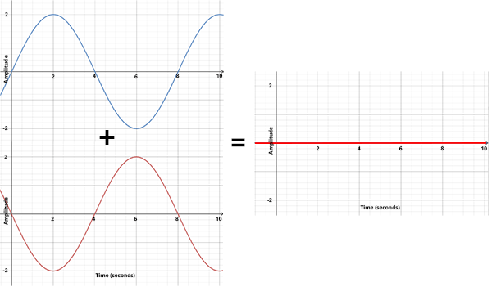
180 Degrees Out of Phase Waveforms
180 degrees out of phase waves sum together, cancelling one another

Slide 10
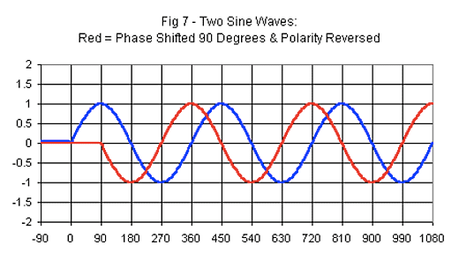
90 Degrees Out of Phase Waveforms

Slide 11
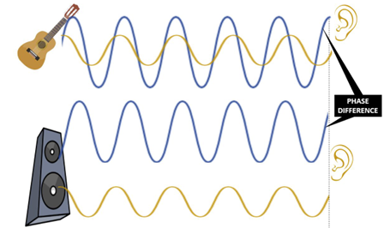
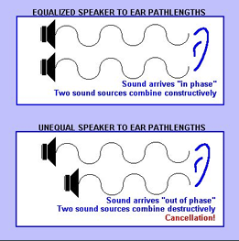
Phase Coherence in Speaker Context
Alignment of two sound waves

Slide 12
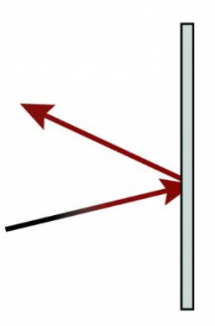
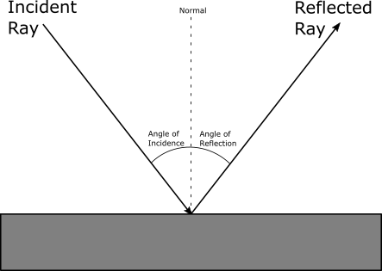
Sound Wave Reflectivity
Straight line reflection

Slide 13
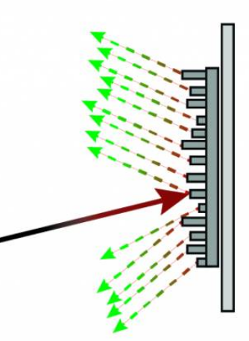
Diffusion
Reflective Waves
Diffuse Surface
Incident Wave

Slide 14
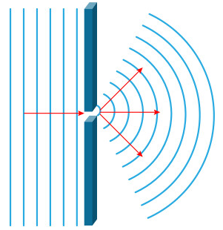
Diffraction Reformation
Barrier with small opening blocking waves
Waves curve as they exit opening
Diffraction through small opening

Slide 15
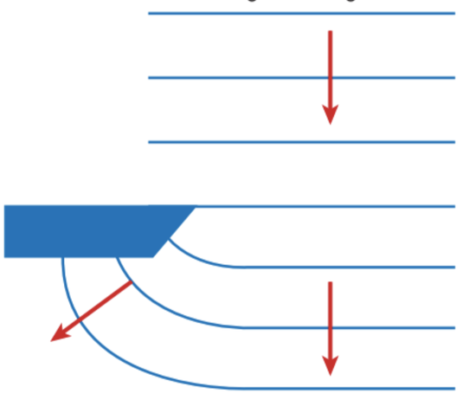
Diffraction Curve
Sound waves curve around object after they pass it
Object blocking path

Slide 16
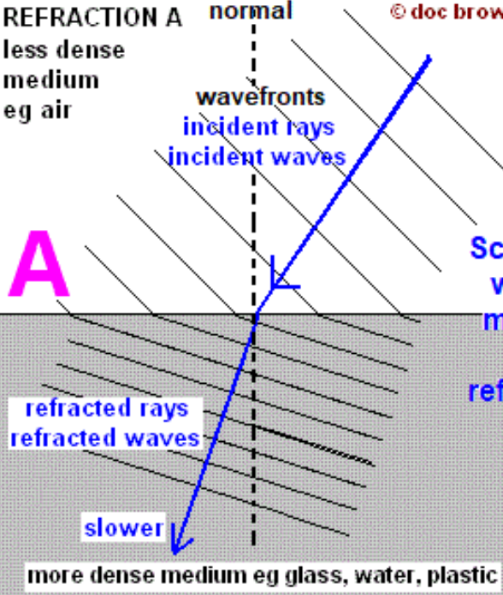
Solid Line Transmission

Slide 17
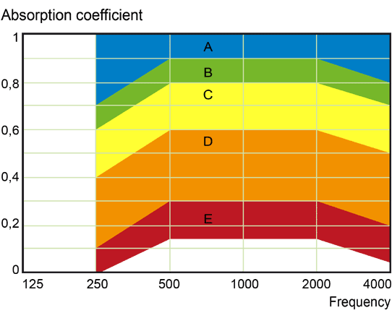
Absorption and NRC
Higher NRC Values mean better absorption
The Noise Reduction Coefficient (commonly abbreviated NRC) is a scalar representation of the amount of sound energy absorbed upon striking a particular surface. An NRC of 0 indicates perfect reflection while an NRC of 1 indicates perfect absorption.

Slide 18
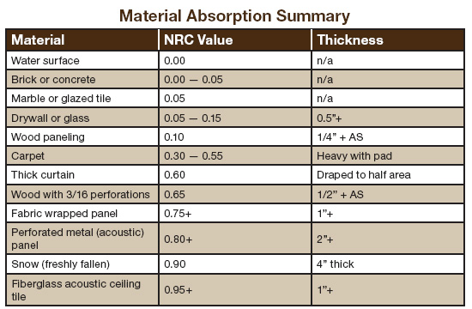
Materials NRC Ratings

Slide 19
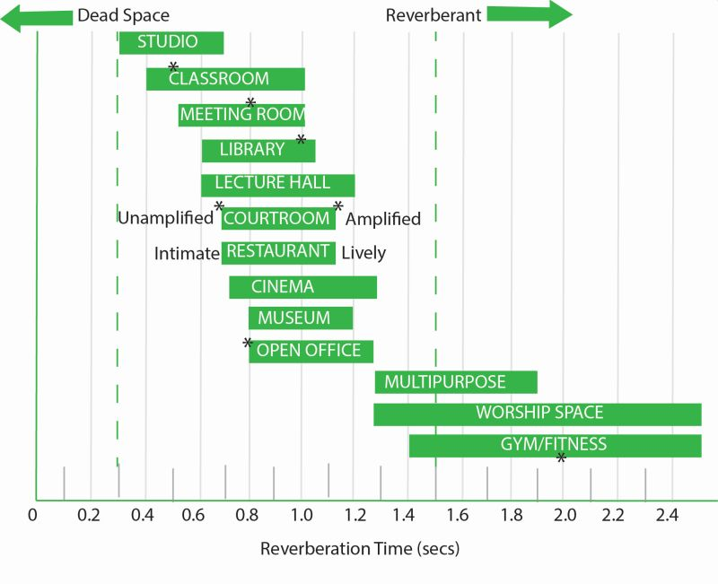
Room Reverberation
Determines how a room can be used for certain practices
Short reverb would be better for studio work
Longer reverb would be better for choirs

Slide 20
Speech Intelligibility
Takes into account 4 factors:
Room Geometry
Reverberation Time
S/N Ratio (Signal to Noise)
Background Noise Level
1000 Hz – 4000 Hz contributes to 75% of speech intelligibility

Slide 21
How to get good Acoustics?
1) Watch out for SOUND REFLECTIONS. Straight surfaces reflect sounds back into the central space making sound clarity muddy.
2) Select ACOUSTICAL TREATMENT carefully. Different materials absorb sound frequencies differently. Make sure your acoustical treatments are absorbing the right sound frequencies.
3) Diminish ECHOES when necessary. Be aware that sounds traveling within 30 milliseconds of each other are perceived without echo. Sounds traveling after the 30 millisecond threshold become echoes of the original sound.
4) Don’t let other building systems get in the way. NOISE CONTROL is important to keep in check as other building systems (like HVAC systems) operate. Keep such clashing noises to a minimum.
5) Keep objects or other OBSTRUCTIONS out of the way. Objects that obstruct a sound path can block high frequency sounds. (Low frequency sounds can bend around objects.)
6) Get good PATTERN CONTROL. Make sure sound systems for a room get good sound coverage. This will prevent feed-back and other sound distortions.

Slide 22
Topic 3: Loudspeaker Design Goals and Traits

Slide 23
What Makes a Good Speaker?
Depends on use
Ex. Mixing and Mastering, General listening, speech intelligibility, home theater, etc.
Balance between visual aesthetic and sound quality
Frequency Response: Accurate reproduction of a wide range of frequencies without significant peaks or dips.
Low Distortion: Minimal harmonic and intermodulation distortion for faithful audio reproduction.
Power Handling: Efficiently handles power from the amplifier without distortion or damage.
Sensitivity: Converts electrical power into sound efficiently, producing higher sound levels with less power input.
Build Quality: High-quality materials, sturdy enclosures, and well-designed components ensure durability and optimal performance.

Slide 24
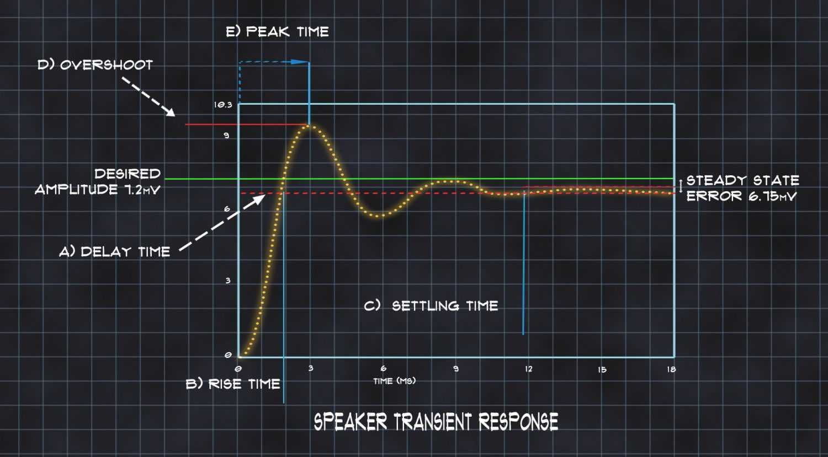
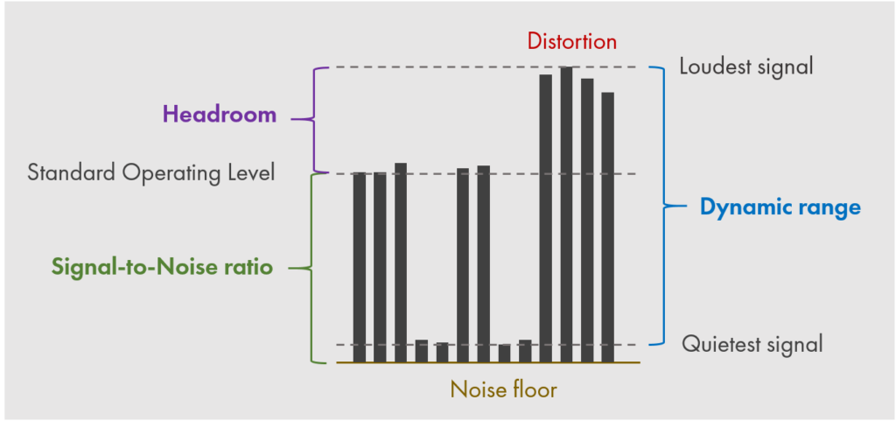
Crucial Loudspeaker Traits
Dynamic Range
Difference between the quietest and loudest sounds a speaker can reproduce without distortion or compression.
Transient Response
How quickly and accurately a speaker can reproduce sudden changes in the audio signal, such as fast percussive sounds or sharp transients.

Slide 25
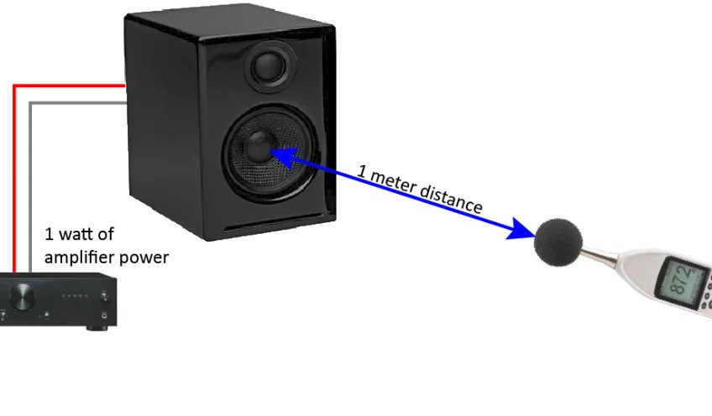
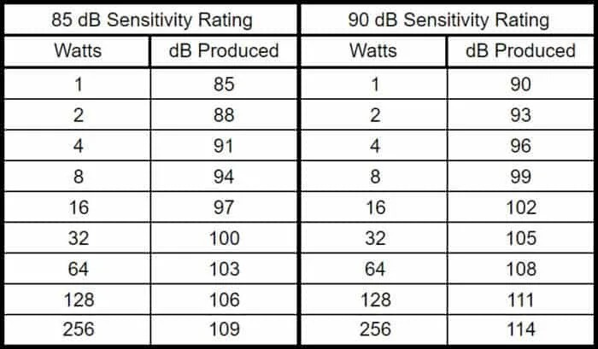
Crucial Loudspeaker Traits
Efficiency
How effectively a speaker converts electrical power into sound output.
Also known as “Sensitivity”

Slide 26
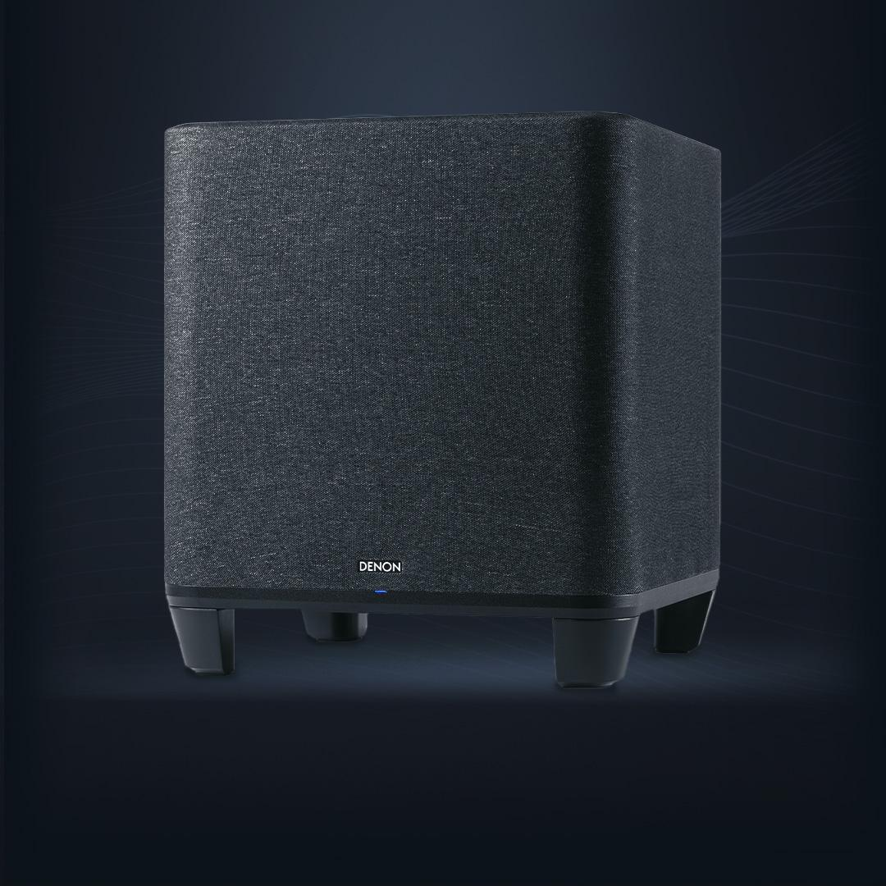
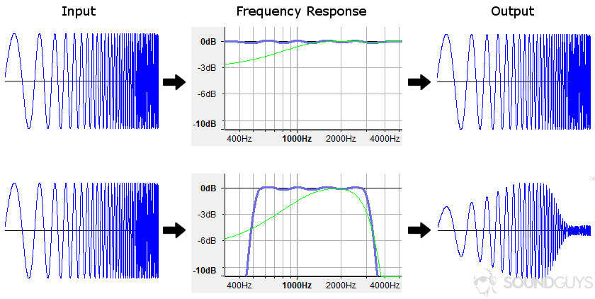
Crucial Loudspeaker Traits
Bass Response
A speaker's ability to accurately reproduce low-frequency sounds, typically those below 250 Hz.

Slide 27
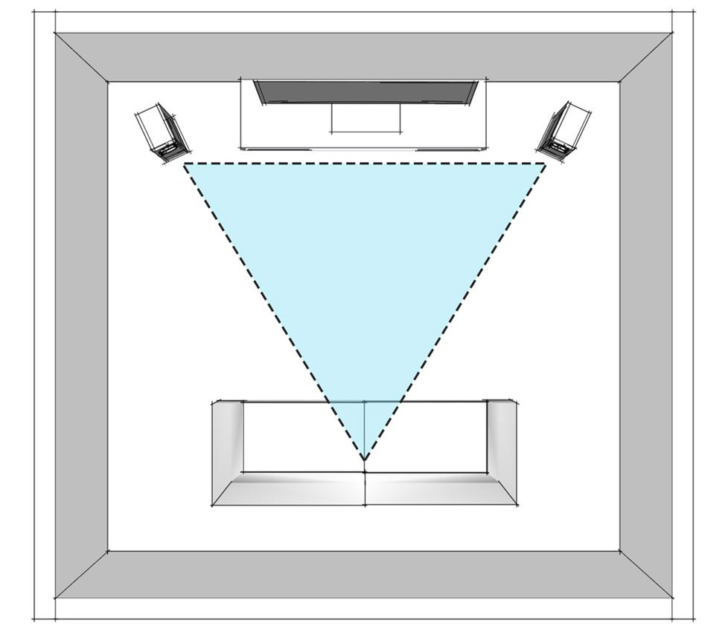
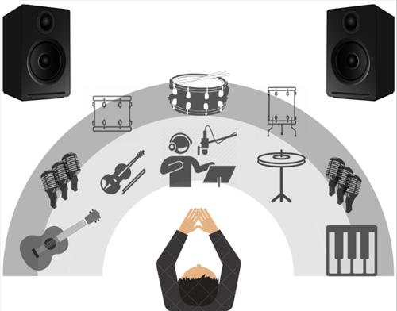
Crucial Loudspeaker Traits
Imaging
The ability of a speaker system to create a precise and stable soundstage, where individual instruments and voices are perceived as coming from distinct locations within the stereo field.

Slide 28
Topic 4: Speaker Types

Slide 29
Types of Speakers
Bookshelf Speakers
Floor-standing Speakers
In-wall Speakers
In-ceiling Speakers
Outdoor Speakers
Portable Speakers
Subwoofers
Soundbars
Satellite Speakers
Studio Monitors.
Computer Speakers
Line Array Speakers

Slide 30
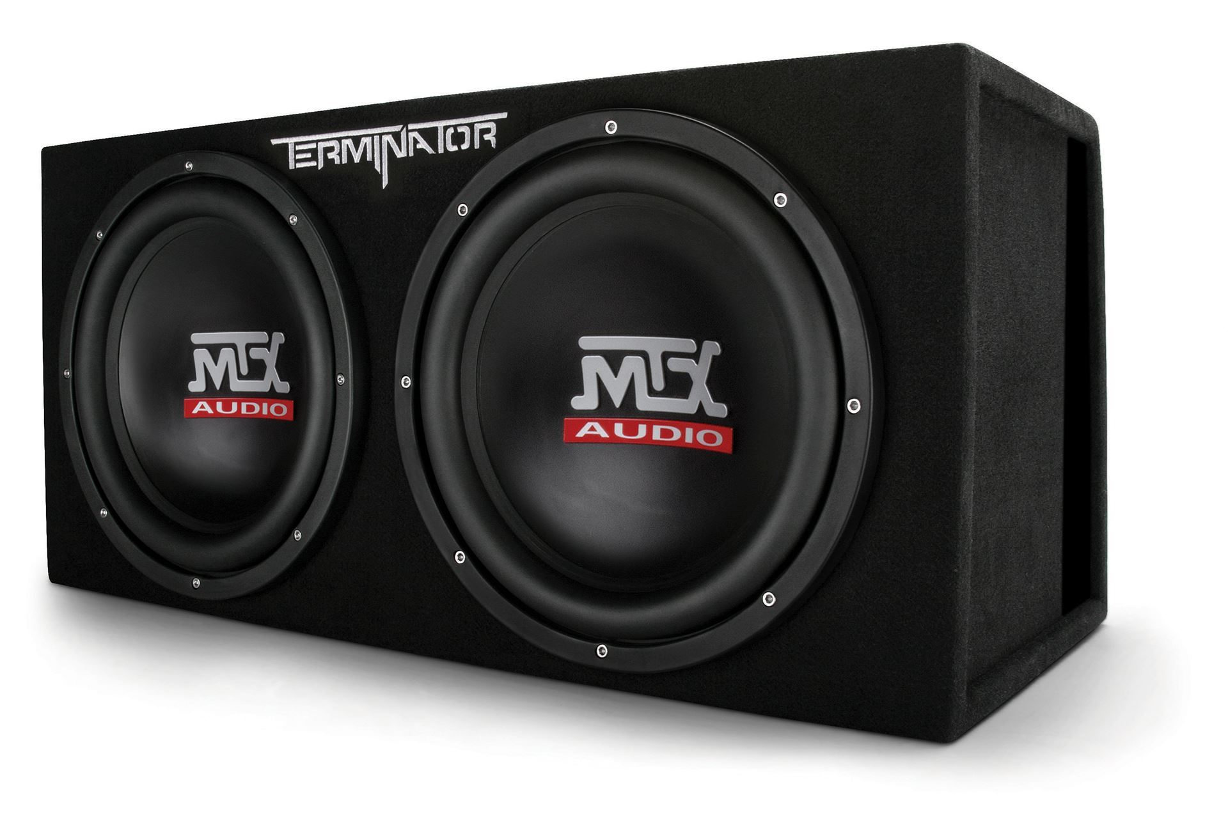
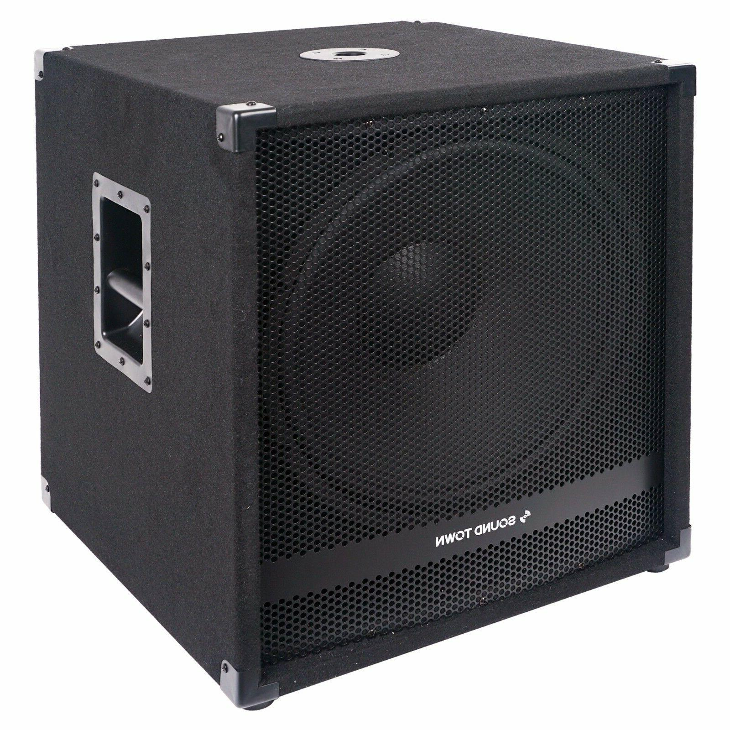
Subwoofers
These are speakers that specialize in reproducing low-end information (Bass).

Slide 31
Subwoofers cont.
Size: Subwoofers are typically larger in size compared to other speakers due to the need for housing larger drivers that can produce low-frequency sounds effectively.
Driver: Subwoofers contain a specialized driver called a woofer, which is designed specifically to reproduce low-frequency bass sounds. The diameter of the woofer is usually larger than that of other speaker drivers, often ranging from 8 inches to 15 inches or more.
Enclosure: Subwoofers are housed in an enclosure, which can be sealed or ported (vented). The enclosure helps control the movement of air generated by the woofer, enhancing bass response and preventing distortion.
Weight: Due to their larger size and heavier construction, subwoofers tend to be heavier than other types of speakers, especially when equipped with powerful amplifiers and sturdy enclosures.
Construction Materials: Subwoofers are often constructed using materials such as wood, MDF (medium-density fiberboard), or plastic for the enclosure, and reinforced materials for the driver cone to withstand the forces generated by low-frequency vibrations.
Amplification: Many subwoofers come with built-in amplifiers (known as powered or active subwoofers), while others require external amplification (passive subwoofers). The amplifier provides the necessary power to drive the woofer and produce deep, powerful bass tones.

Slide 32
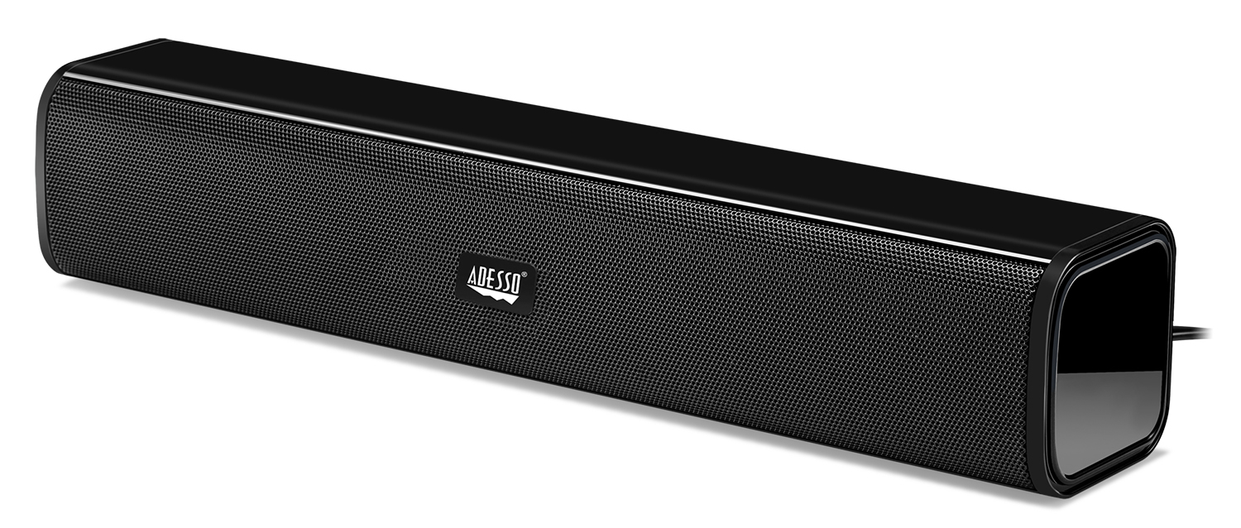
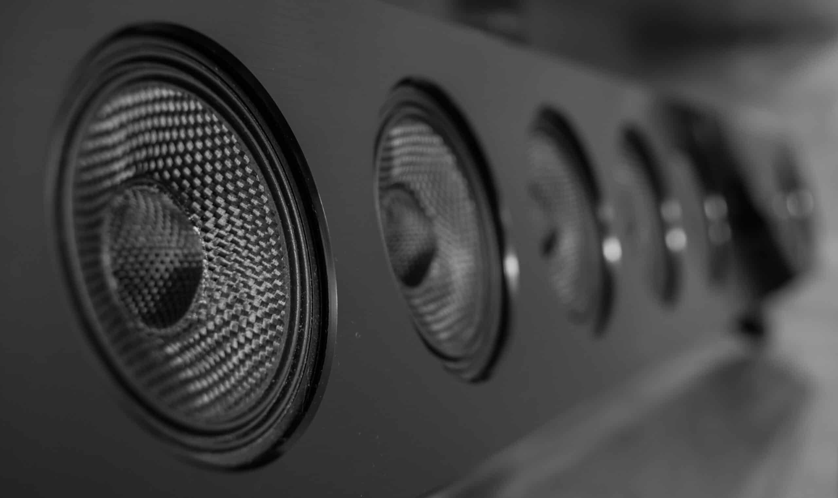
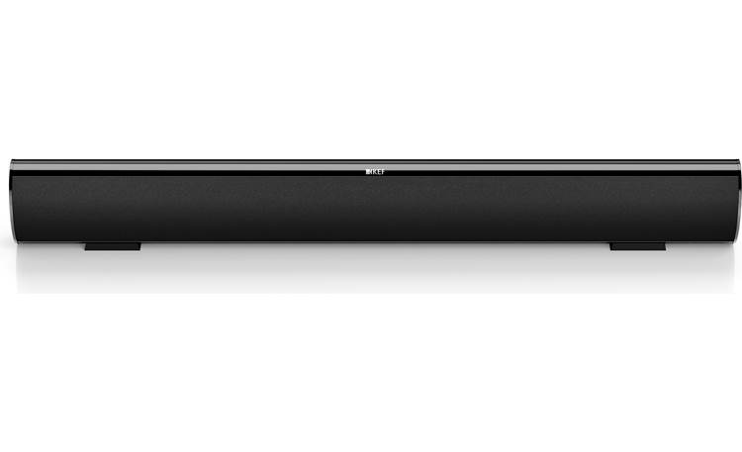
Soundbars
Long, narrow speakers that offer an all-in-one audio solution, often used to enhance TV sound quality without the need for multiple speakers.

Slide 33
Soundbars cont.
Shape and Size: Soundbars are long and narrow, resembling a rectangular box or cylinder. They are designed to sit in front of or underneath a TV, providing an all-in-one audio solution that doesn't take up much space.
Speaker Drivers: Inside the soundbar, there are multiple speaker drivers arranged horizontally. These drivers can include woofers for bass, tweeters for high frequencies, and mid-range drivers for vocals and instruments.
Enclosure: The enclosure of a soundbar is typically sleek and streamlined, often made of materials like plastic or metal. The design of the enclosure helps to distribute sound evenly across a room and can sometimes include built-in features like mounting brackets for wall installation.
Connections: Soundbars usually have various input and output connections, such as HDMI, optical, or Bluetooth. These connections allow you to easily connect the soundbar to your TV, media player, or smartphone wirelessly or with cables.
Controls: Most soundbars come with integrated controls on the unit itself or a remote control for adjusting volume, selecting audio modes, and controlling other settings.
Subwoofer: Some soundbars come with a separate subwoofer unit, which can be wireless or wired, to enhance bass performance and provide a more immersive audio experience, especially for movie soundtracks and music.

Slide 34
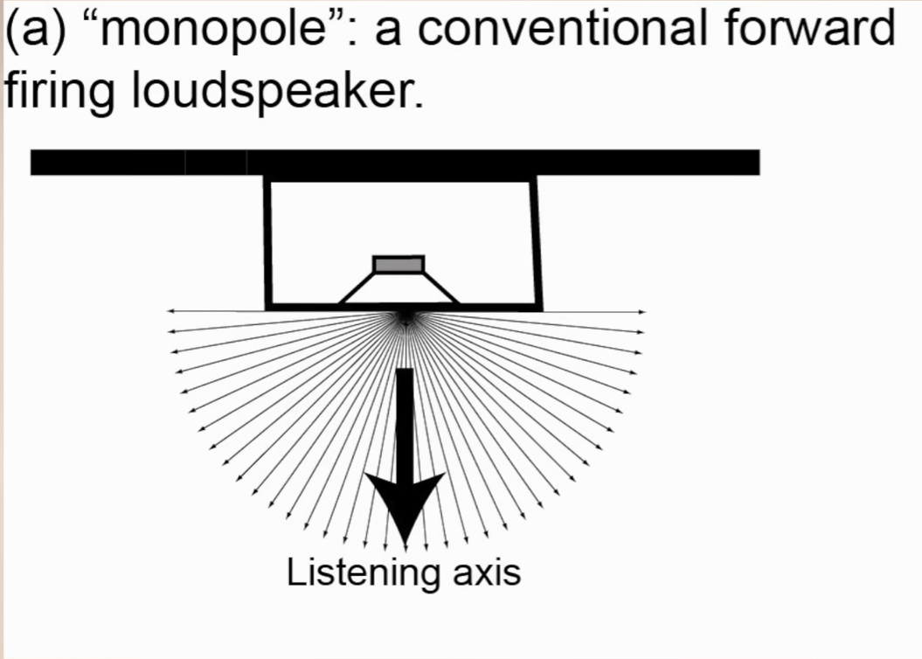
Surround Sound Speakers - Monopole
This type of surround sound speaker is similar to regular speakers you might see at home.
It's a single enclosure (the box) that emits sound primarily from the front, like most speakers.
In a surround sound setup, these speakers are typically positioned in front of or behind the listener, providing direct sound that enhances the overall audio experience.

Slide 35
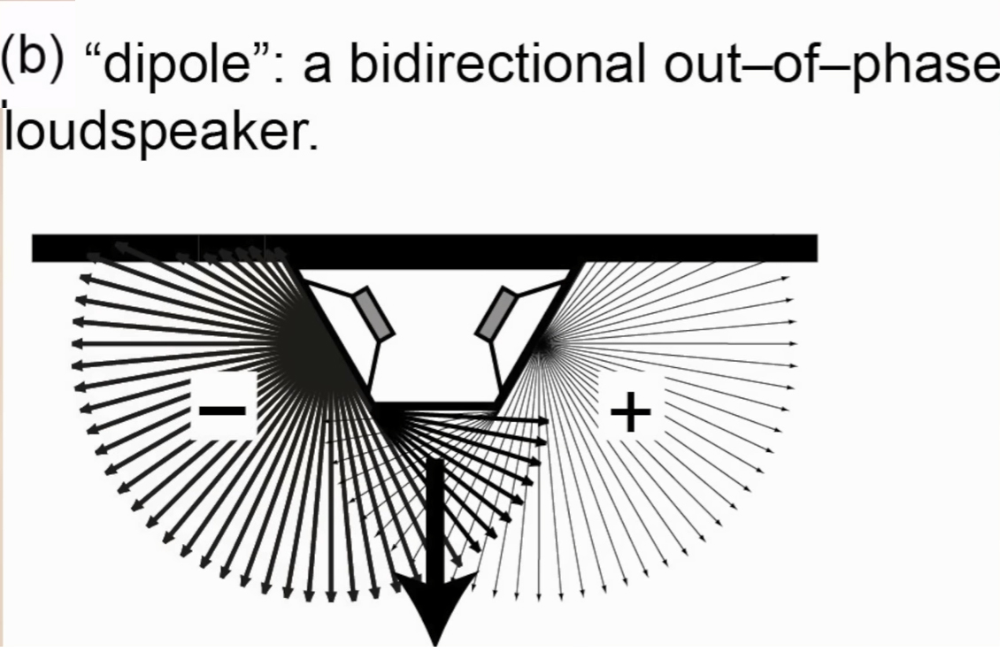
Surround Sound Speakers - Dipole
Dipole surround sound speakers emit sound both forward and backward.
They have two sets of drivers facing opposite directions within the same enclosure.
This design creates a more diffuse sound field, which can enhance the sense of immersion in a surround sound setup.
Dipole speakers are often used for side or rear surround channels in home theater systems.

Slide 36
Surround Sound Speakers - Dipole
Dipole surround sound speakers emit sound both forward and backward.
They have two sets of drivers facing opposite directions within the same enclosure.
This design creates a more diffuse sound field, which can enhance the sense of immersion in a surround sound setup.
Dipole speakers are often used for side or rear surround channels in home theater systems.

Slide 37
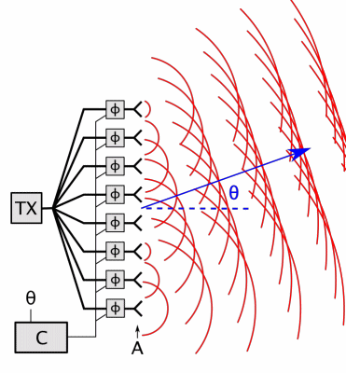
Line Arrays
Commonly used for live sound events
Line array surround sound speakers consist of multiple smaller speaker units arranged vertically or horizontally in a line.
This design helps to focus sound in a specific direction, providing more precise and controlled audio coverage in large venues or theaters.
Line array speakers are commonly used in professional audio setups for concerts, theaters, and stadiums

Slide 38
Topic 4.5: Bass Loading and Enclosures

Slide 39
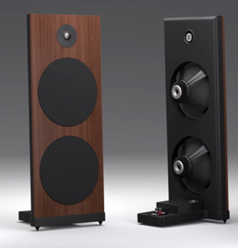
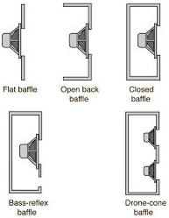
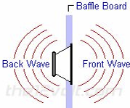
Types of Enclosures: Open Baffle
No box contains the drivers
Speaker is flat board

Slide 40
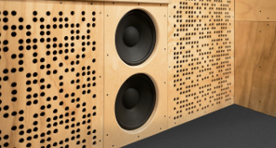
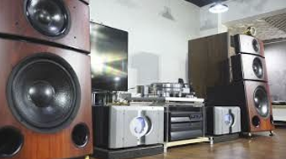
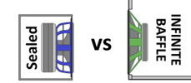
Types of Enclosures: Infinite Baffle
A very huge, very big speaker
So much air would be in that cabinet that a driver moving, wouldn't cause compression of air

Slide 41
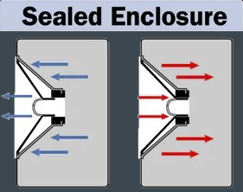
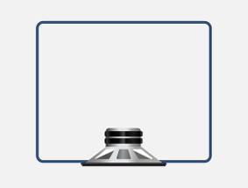
Types of Enclosures: Sealed
All sound comes from the front of the speakers themselves
Air is trapped inside cabinet
Acts as a spring to control movement
Compact and easy to build
Prevents sound waves from the back cancelling out the front
Lots of internal air pressure
Good power handling

Slide 42
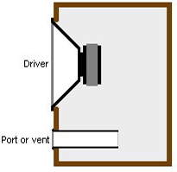
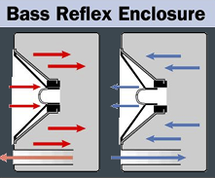
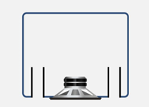
Types of Enclosures: Vented (Ported)
Also called “Bass reflex enclosures”
Has vent in front or rear side of cabinet
Allows pressure to be equalized (Inside and outside)
Used to tune cabinet to certain low frequencies based on how speaker is being used
Helps increase low frequency output

Slide 43
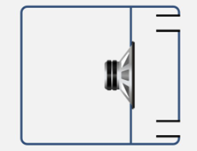
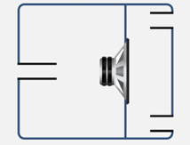
Bandpass
Subwoofer enclosure that has two separate chambers instead of one
Has filter that limits the high frequency response (effect is found in secondary chamber)
Primary chamber can be vented or sealed
Can also be single or dual vented
Produces low frequencies within a limited bandwidth
Highly efficient

Slide 44
Topic 5: Subwoofers

Slide 45
What is a subwoofer?
Subwoofers are loudspeakers designed to produce bass and sub-bass.
Frequency range is generally 20-200 Hz
Always used with other regular speakers
Connected to an amp, which provides power

Slide 46
Single Woofer setup vs. Multi Woofer setup
Convenience, multiple small subwoofers take up less space than one giant one.
Bass is omnidirectional
The more subs, the greater power load is taken off one another.
Typically not used for directing the bass in a certain direction. (Bass is omnidirectional)

Slide 47
Subwoofer integration with main speakers
Using crossovers, different frequency ranges can be distributed to different speakers that can handle low, mid, and high frequencies optimally.
Give main speakers mid and high frequency playback
Leave sub/subs to play low frequencies

Slide 48
Topic 5.5: Woofers and Midrange in depth

Slide 49
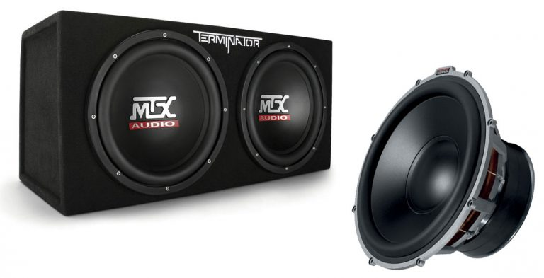

More in depth look at woofers…

Slide 50

Mechanics
Two Speakers in Parallel
Impedance decreases
Volume increase from more flow through circuit
Two Speakers in Series
Impedance increases
Volume decrease due to voltage drop in circuit

Slide 51


Suspension
Provides flexibility for diaphragm
to move back and forth

Slide 52

The Motor
Drives diaphragm movement

Slide 53
Cone Material
Paper
Lightweight and damping
Kevlar
High strength to weight ratio
Aluminum/Metal
High rigidity and low resonance and good transient response
Carbon Fiber
Lightweight and high stiffness

Slide 54
Topic 6: Tweeters

Slide 55

Voice Coil
A winding of a wire, usually copper or aluminum that is wrapped around a former (bobbin) and then attached to the apex of a speaker cone
Produces a varying magnetic field, works against a magnet’s fixed magnetic field.
Forces move coil off center position. ○ Mechanical movement is (hopefully) analogous to electrical waveform supplied by the amplifier's output to the voice coil
Since the coil is attached to a diaphragm, the voice coil’s vibratory motion transmits to the diaphragm.

Slide 56

Voice Coil
Passing too much current through the coil can cause it to overheat.
Ribbon-wire provides a higher packing density in the magnetic gap than coils wrapped with round wire.
Surface-sealed bobbin & collar materials
Excessive input power at low frequencies can cause distortion and possibly mechanical damage

Slide 57

Diaphragm Materials
Tweeter materials are usually more rigid and thin to produce higher frequencies.
Warm or Detailed
Don’t want ringing so need well-damped material

Slide 58

What makes a good tweeter?
Light & stiff
Good dampening

Slide 59
Topic 7: Crossovers

Slide 60
What is a crossover?
The process of splitting an audio signal and sending specific filtered frequencies to multiple speakers that will more efficiently handle the frequency range sent.
Passive or Active
Passive does not require power
Requires power from amplifier
Contains filters that direct low, mid, and high frequencies to specific outputs.
Sub
Woofer
Tweeter

Slide 61


Capacitors, Inductors & Resistors
Capacitor: High Pass Filter
Inductor: Low Pass Filter
Resistor: Balances output level across all drivers. (Controls Impedance)

Slide 62




Order of Crossover 1st – 4th
First-order (6 dB/octave): Gradually attenuating frequencies beyond the crossover point.
Second-order (12 dB/octave): Steeper slope, providing better separation between frequency ranges
Third-order (18 dB/octave): Even steeper than the second-order. ensures more distinct separation between drivers
Fourth-order (24 dB/octave): Sharpest slope, allowing precise control over the frequency response

Slide 63


Types of Crossovers
Linkwitz-Riley: Combo of 2 butterworth filters, no 3dB peak.
Butterworth: Digital, 3dB peak at crossover point.

Slide 64
Topic 8: Cabinet Design

Slide 65





Cabinet Resonance
Cabinet Resonance- When the mid- bass driver or subwoofer exerts pressure on the cabinet walls causing them to resonate and add unwanted sounds
When the speaker driver moves it pumps air in the cabinet, this puts pressure on the cabinet walls causing them to flex and vibrate.
The more mass you add, the heavier the damping
= less resonance
To avoid, use dampening materials or add mass.
Polyfil
Fiberglass
Rockwool
Foam
Felt

Slide 66


Panel Thickness and Resonant Frequency
The thinner the panel the more you're hearing the resonance of the case.
The thicker the panel the more you're hearing of the driver output.
Resonant Frequency - Where the audio peaks in the resonance
Internal Volume- How loud it is within the casing without damping

Slide 67

Bracing
Bracing pushes resonant frequency higher
Physical EQ
Triangular bracing is most effective

Slide 68



Internal Reflection
When drivers move back and forth, they send sound both forwards and backwards
Sound waves bounce off the back of the cabinet and hit the back of the driver, creating coloration / bias
Irregular-shaped cabinet would help disperse / redirect rear sound waves

Slide 69
Internal Reflection
When drivers move back and forth, they send sound both forwards and backwards
Sound waves bounce off the back of the cabinet and hit the back of the driver, creating coloration / bias
Irregular-shaped cabinet would help disperse / redirect rear sound waves

Slide 70
Topic 9: Transducer types

Slide 71
What are transducers
A sound transducer is a device that can convert Sound Signals into electrical signals or electrical signals into sound signals
Input Sound Transducers: Microphones, guitar pickups
Output Sound Transducers: Speakers

Slide 72



Types of Transducers
Electrostatic:
Conductive diaphragm placed between two conductive plates
Uses positive and negative polarity switching to create vibrations
Ribbon:
Strong and lightweight metalized film ribbon suspended between a set of high power magnets.
No voice coil
Dynamic Cone:
Consists of a voice coil attached to a diaphragm

Slide 73



Motor Types
Planar:
Planar magnetic drivers are electrostatic drivers that use a flat diaphragm to produce sound.
Air Motion Transfer:
Electromagnetic Driver
Tactile Transducers:
Attached to seating to increase bass sensation.
Allows listener to “Feel” the bass more

Slide 74
Topic 10: Thiele Small Parameters (TS Parameters)

Slide 75
What are T/S Parameters?
Thiele-Small parameters are a set of measurements used to define the mechanical, electrical, and electromechanical properties of loudspeakers and speaker design.
They provide information about the design and performance of a speaker.
How big the housing should be.
How long should the bass reflex opening should be.

Slide 76
Common TS Parameters
Resonant Frequency (Fs)
DC Resistance (Re)
Mechanical Q Factor (Qms)
Electrical Q Factor (Qes)
Total Q Factor (Qts)
Mechanical Resistance (Rms)
Equivalent Volume of Air (Vas)
Sensitivity (SPL)
Effective Piston Area (Sd)
Linear Excursion (Xmax)

Slide 77
Which parameters matter for woofers?
Resonant Frequency (Fs): This is the frequency where the speaker/subwoofer plays with the least effort in a free air situation. This also determines the lower frequency limit of the driver’s usable range.
This is less important for tweeters since they operate at higher frequencies.
Excursion Distance Before Distortion (Xmax): The Xmax is the maximum distance of travel before DISTORTION.

Slide 78
Power Handling
Power handling refers to the maximum amount of electrical power a speaker can handle without being damaged. It's typically specified in terms of both continuous (RMS) power and peak power.
Exceeding the rated power handling can lead to distortion, overheating, or even physical damage to the speaker.

Slide 79

Sensitivity
Sensitivity, often expressed in decibels (dB), measures the sound pressure level (SPL) produced by the speaker when driven by a standard input power level.
Sensitivity is measured with an input power of 1 watt and at a distance of 1 meter from the speaker.
A higher sensitivity rating indicates that the speaker produces louder sound for the same input power compared to a speaker with lower sensitivity.
Sensitivity influences efficiency

Slide 80

Sensitivity and Power Handling Relationship
Efficiency: A speaker with higher sensitivity generally converts more electrical power into sound energy efficiently.
Power Requirements: Speakers with higher sensitivity require less power to produce a given volume level than speakers with lower sensitivity.
System Design: A speaker with high sensitivity might be paired with a lower-powered amplifier and vice versa.

Slide 81
Compliance (Cms) and Bass Loading
Refers to how easily a speaker's cone can move back and forth in response to changes in air pressure.
The compliance of the woofer affects how it behaves in different types of enclosures used for speakers, particularly in ported and sealed.

Slide 82
Topic 11: Loudspeaker Specifications

Slide 83

Revisiting Power Handling
Peak: the absolute most amount of power run through the system
Refers to overall most watts possible
Not long term
RMS (root mean square) : the average of how high the power can be run "comfortably“
Refers to continuous use
Equation to see values over time

Slide 84

Units of Measurement
dB = unit of volume
KHz= unit of frequency
The cycle of a specific frequency
Meter = unit of distance
Related to distance sound waves move
Watt = unit of Power
Amp sending too many watts can destroy speaker
Too little can cause clipping

Slide 85
Pro vs. Home Audio
HOME - REGULAR
Ease of Use
Pleasurable frequency curve.
Boost in bass and treble
Not accurate because of this
PRO - STUDIO
Accurate, Flat, sound reproduction
Durability

Slide 86
Consumer preferences
Size
6×9-inch, 6.5-inch, 5 1/4-inch, 4-inch, and 3.5-inch.
Common sizes include 6.5", 8", and 12"
These common speaker sizes produce a diverse range of tones.
Not accurate because of this
Visual aesthetic
Enclosure material
Bass/punch

Slide 87
Vented vs Sealed dispersion
Vented allows for more reinforcement of low bass frequencies giving the illusion of more bass.
Sealed allows for more controlled and “tight” low end response without any extra bass reinforcement.

Slide 88








Types of connectors
SpeakOn
Banana plug
¼” Phono
Bare wire
XLR

Slide 89

Stranded vs. Solid core
Stranded core has many ‘outside’ circumferences, which reduces high frequency losses
Solid core can only bend a few times before it cracks and breaks.
Stranded core wire is way more flexible and is exclusively used as speaker wire

Slide 90
Topic 12: Amplifiers and Signal Processing

Slide 91



Amplifiers
Increase voltage, current, or power of a received signal.

Slide 92

Power Supply
A power supply allows enough power to get to an amp and will also can reduce noise and interference
Amplifier power is calculated
Voltameter is measured in volts
Ammeter measured in amps
Ohmmeter measures resistance in Ohms
Power (watts) = Voltage squared by Resistance
Take the voltage (blue) a square it, then divide that by the constant, and we get the power output (orange)
Calculator for Amp Power
Amplifier power is basically the average continuous

Slide 93



Amplifier Types
Class A
Hi-Fi
Always run at full-power
Expensive
Class AB
Hi-Fi
Running more than half the time
Don’t turn on and off abruptly
High efficiency
Class D
Utilizes PWM (Pulse Width Modulation) to amplify audio signals.

Slide 94


Parallel vs. Series Wiring
Wiring in series increases the impedance. This is calculated by multiplying the number of speakers by their impedance. For example:
2x speakers @ 8Ω = 16Ω
2x speakers @ 4Ω = 8Ω
4x speakers @ 4Ω = 16Ω
Wiring in parallel reduces the impedance. This is calculated by dividing the number of speakers by their impedance. For example:
2x speakers @ 8Ω = 4Ω
2x speakers @ 16Ω = 8Ω
4x speakers @ 16Ω = 4Ω

Slide 95
Signal Processing
Some amplifiers have built in signal processing.
Crossovers
Low Cuts
Delays
Limiters

Slide 96

Low Cut / Bass Cut
Can be either a function of EQing or the crossover itself
Removes lower frequencies from a speaker to avoid trying to reproduce bass that is too low for it to play without distorting
The louder you get, the higher the low cut needs to be to avoid overdriving the woofer, even with subwoofers

Slide 97

Delays and Time Alignment
Delays can delay the audio signal for a specific amount of time before allowing it to pass.
Them amount of delay can be either expressed in time or distance
Short delays are smaller values used for time alignment of individual drivers within a single speaker. Typically < 1’
Long delays are larger values used to time align one speaker to another speaker. Can be any distance up to hundreds of feet.

Slide 98
Delays and Time Alignment cont.
Time alignment is a means of delaying one speakers input signal relative to another so that the sound from each speaker arrives to you at the same time
Can delay full range speaker or individual drivers to compensate for differences in distance between one another.
Delays can allow for out-of-phase waveforms to be pushed back into phase coherency.

Slide 99

Limiter
Cap peak signal getting to the amplifier(s)
Used to keep speakers from being played to loud, either for their protection or for audience protection
Keeps inexperienced system operators from blowing up speakers or hurting the audience

Slide 100
Topic 13: Room Acoustics and Speaker Placement

Slide 101
What are room acoustics?
The behavior of sound in an enclosed space.
Dependent on:
Architecture of room
Surface materials
Room size and dimensions
Room noise bleed

Slide 102

Room size and dimensions
Certain ratios between dimensions can distribute sound modes more evenly and minimize the impact of standing waves and resonances.
Specific ratios have been shown to mitigate problematic sound wave behavior.
Golden ratio: 1 x 1.6 x 2.56

Slide 103
Noise Bleed
Noise - Unwanted Sound
Noise Floor - The constant level of noise in a room, added up from all noise sources
Noise From Outside
Noise From Inside
Noise Criteria (NC) - a rating system for background noise levels

Slide 104


Reducing Bleed
Walls
Insulation
Double Studs
Soundproofing
Floor
Concrete
Floating floors
Carpets
Risers
Ceiling
Carpeting above
Insulation
Windows
Double Pane
Sound Dampening around edge
Doors
Double lock
Weather stripping
Heavy doors

Slide 105


Room Modes and Materials
Axial
Tangential
Oblique
Non-Parallel walls
Break up standing waves
Different materials have different absorption properties.
Acoustic foam and diffusers
Strategically placed to mitigate room

Slide 106

Speaker placement
Whole space: Speakers are placed away from walls and corners, and no EQ is necessary
Half space: Speakers are close to one wall, and the bass should be rolled off by 2 to 6 dB
Quarter space: Speakers are placed near corners, and the bass should be rolled off by 4 to 12 dB

Slide 107



Speaker Alignment Positions

Slide 108
Dispersion
Narrow dispersion is undesirable
Dispersion changes with frequency
Low frequencies have wider dispersion
High frequencies are more directional

